Slide 1
Basics of C#

Slide 2
Overview
C# is pronounced as "C-Sharp".
It is an object-oriented programming language provided by Microsoft that runs on . Net Framework.
Anders Hejlsberg is known as the founder of C# language.
C# has evolved much since their first release in the year 2002.
It was introduced with .NET Framework 1.0
The most recent version is 9.0, which was released in 9.0 / November 10,2020 in .NET 5.0 and included in Visual Studio 2019 version 16.8.

Slide 3
To Develop Applications
By using c # we can develop
Mobile applications
Desktop applications
Web applications
Web services
Web sites
Games
Database applications

Slide 4
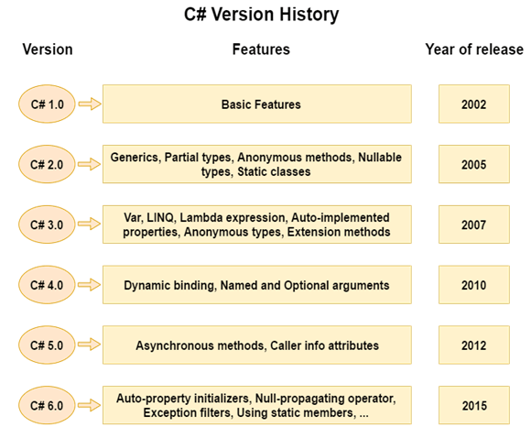

Slide 5
Basic Program in c#
using System;
namespace Test
{
class Program
{
public static void Main(String args[])
{
System.Console.WriteLine("Hello, world!");
}
}
}

Slide 6
Program explanation
Let us look at the various parts of the given program −
using System; - the using keyword is used to include the System namespace in the program A namespace is a collection of classes.
using System means that we can use classes from the System namespace.
A namespace is designed for providing a way to keep one set of names separate from another. The class names declared in one namespace does not conflict with the same class names declared in another.
class is a container for data and methods
Program is the class name. A class is a blueprint which from objects is created
Methods define the behavior of the class.
static: is a keyword which means object is not required to access static members. So it saves memory.
void: is the return type of the method. It does'treturn any value. In such case, return statement is not required.

Slide 7
Program explanation
The next line defines the Main method, which is the entry point for all C# programs. The Main method states what the class does when executed.
Main: is the method name. It is the entry point for any C# program. Whenever we run the C# program, Main() method is invoked first before any other method. It represents start up of the program.
string[] args: is used for command line arguments in C#. While running the C# program, we can pass values. These values are known as arguments which we can use in the program.
System.Console.WriteLine("Hello World!"): Here, System is the namespace. Console is the class defined in System namespace. The WriteLine() is the static method of Console class which is used to write the text on the console.

Slide 8
Comments & keywords & identifiers In C#
C# comments
Comments are used for explaining code. Compilers ignore the comment entries.
The multiline comments in are start with /* and terminates with the characters */
Syntax: /* This are the multi line
comments for C# */
Single-line comments are indicated by the '//' symbol. For example,
Syntax: //This is c# programming class
C# Keywords
Keywords are reserved words predefined to the C# compiler. These keywords cannot be used as identifiers.
C# identifiers
An identifier is a name used to identify a class, variable, function, or any other user-defined item.
A name must begin with a letter that could be followed by a sequence of letters, digits (0 - 9) or underscore. The first character in an identifier cannot be a digit.

Slide 9
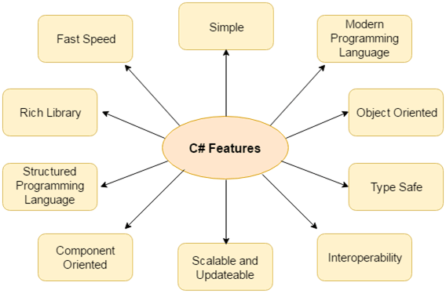
Features of c#

Slide 10
Fearures of c#
1) Simple
C# is a simple language in the sense that it provides structured approach (to break the problem into parts), rich set of library functions, data types etc.
2) Modern Programming Language
C# programming is based upon the current trend and it is very powerful and simple for building scalable, interoperable and robust applications.
3) Object Oriented
C# is object oriented programming language.
4) Interoperability
Interoperability process enables the C# programs to do almost anything that a native C++ application can do.
Interoperability of programming languages is the ability for two or more languages to interact as part of the same system. Frequently, this means passing messages and data between potentially very different languages.

Slide 11
Features of c#
5) Scalable and Updateable
C# is automatic scalable and updateable programming language. For updating our application we delete the old files and update them with new ones.
Scalability in the sense it supports for future extenstability
6) Structured Programming Language
C# is a structured programming language in the sense that we can break the program into parts using functions. So, it is easy to understand and modify.
7) Rich Library
C# provides a lot of inbuilt functions that makes the development fast.
8) Fast Speed
The compilation and execution time of C# language is fast.

Slide 12
Variables in C#
A variable is nothing but a name given to a storage area that our programs can manipulate.
Each variable in C# has a specific type, which determines the size and layout of the variable's memory the range of values that can be stored within that memory and the set of operations that can be applied to the variable.
int - stores integers (whole numbers), without decimals, such as 123 or -123
double - stores floating point numbers, with decimals, such as 19.99 or -1 1 19.99
char - stores single characters, such as 'a' or 'B'. Char values are surrounded by single quotes
string - stores text, such as "Hello World". String values are surrounded by double quotes
bool - stores values with two states: true or false
Variable Type | Example
Decimal types | decimal
Boolean types | True or false value, as assigned
Integral types | int, char, byte, short, long
Floating point types | float and double
Nullable types | Nullable data types

Slide 13
Variable Declaration
A variable can have alphabets, digits and underscore.
A variable name can start with alphabet and underscore only. It can't start with digit.
No white space is allowed within variable name.
Syntax of c#
type variableName = value;
A variable name must not be any reserved word or keyword e.g. char, float etc.
int x;
int _x;
int k20;
This how we are Initialize the variables in C#
int myNum = 5;
double myDoubleNum = 5.99D;
char myLetter = 'D’;
bool myBool = true;
string myText = "Hello";

Slide 14
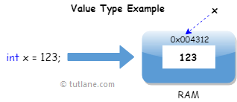
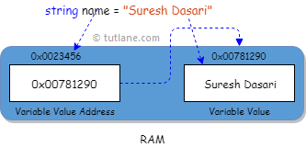
Data types in C#
Data Types are useful to define a type of data the variable can hold
Value Data Type if it holds the value of the variable directly on its own memory space
Reference Types will contain a pointer that points to another memory location that holds the data. The Reference Types won’t store the variable value directly in its memory. Instead, it will store the memory address of the variable value to indicate where the value is being stored.
Type | Data Types
Value Data Type | int, bool, char, double, float, etc.
Reference Data Type | string, class, object, interface, delegate, etc.
Pointer Data Type | Pointers.

Slide 15
Value data types in c #
Data Type | .NET Type | Size | Range
byte | Byte | 8 bits | 0 to 255
sbyte | SByte | 8 bits | -128 to 127
int | Int32 | 32 bits | -2,147,483,648 to 2,147,483,647
uint | UInt32 | 32 bits | 0 to 4294967295
short | Int16 | 16 bits | -32,768 to 32,767
ushort | UInt16 | 16 bits | 0 to 65,535
long | Int64 | 64 bits | -9,223,372,036,854,775,808 to 9,223,372,036,854,775,807
ulong | UInt64 | 64 bits | 0 to 18,446,744,073,709,551,615
float | Single | 32 bits | -3.402823e38 to 3.402823e38
double | Double | 64 bits | -1.79769313486232e308 to 1.79769313486232e308
bool | Boolean | 8 bits | True or False
decimal | Decimal | 128 bits | (+ or -)1.0 x 10e-28 to 7.9 x 10e28
DateTime | DateTime | - | 0:00:00am 1/1/01 to 11:59:59pm 12/31/9999

Slide 16
Reference Data type
The reference data types do not contain the actual data stored in a variable, but they contain a reference to the variables. if the data is changed by one of the variables, the other variable automatically reflects this change in value. There are 2 types of reference data type in c # language. 1) predefined types - such as objects, string. 2 ) user defined types - such as classes, interface.

Slide 17
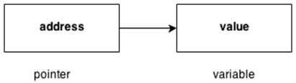
Pointer Data Type
The pointer in C# language is a variable, it is also known as locator or indicator that points to an address of a value.

Slide 18
Operators in c #
Arithmetic Operators
Relational Operators
Logical Operators
Bitwise Operators
Assignment Operators
Misc Operator

Slide 19
Arthemetic Operators variable A holds 10 and variable B holds 20
Operator | Description | Example
+ | Adds two operands | A + B =30
- | Subtracts second operand from the first | A - B =10
* | Multiplies both operands | A * B = 200
/ | Divides numerator by de-numerator | B / A = 2
% | Modulus Operator and remainder of after an integer division | B % A = 0
++ | Increment operator increases integer value by one | A++ = 11
-- | Decrement operator decreases integer value by one | A-- = 9

Slide 20
Relational Operators
Operator | Description | Example
== | Checks if the values of two operands are equal or not, if yes then condition becomes true. | (A == B) is not true.
!= | Checks if the values of two operands are equal or not, if values are not equal then condition becomes true. | (A != B) is true.
> | Checks if the value of left operand is greater than the value of right operand, if yes then condition becomes true. | (A > B) is not true.
< | Checks if the value of left operand is less than the value of right operand, if yes then condition becomes true. | (A < B) is true.
>= | Checks if the value of left operand is greater than or equal to the value of right operand, if yes then condition becomes true. | (A >= B) is not true.
<= | Checks if the value of left operand is less than or equal to the value of right operand, if yes then condition becomes true. | (A <= B) is true.

Slide 21
Logical Operators
Operator | Description | Example
&& | Called Logical AND operator. If both the operands are non zero then condition becomes true. | (A && B) is false.
|| | Called Logical OR Operator. If any of the two operands is non zero then condition becomes true. | (A || B) is true.
! | Called Logical NOT Operator. Use to reverses the logical state of its operand. If a condition is true then Logical NOT operator will make false. | !(A && B) is true.

Slide 22
Bitwise Operators
Assume if A = 60; and B = 13; then in the binary format they are as follows −
A = 0011 1100
B = 0000 1101
-------------------
A&B = 0000 1100
A|B = 0011 1101
A^B = 0011 0001
~A = 1100 0011

Slide 23
Bitwise Operators
Operator | Description | Example
& | Binary AND Operator copies a bit to the result if it exists in both operands. | (A & B) = 12, which is 0000 1100
| | Binary OR Operator copies a bit if it exists in either operand. | (A | B) = 61, which is 0011 1101
^ | Binary XOR Operator copies the bit if it is set in one operand but not both. | (A ^ B) = 49, which is 0011 0001
~ | Binary Ones Complement Operator is unary and has the effect of 'flipping' bits. | (~A ) = -61, which is 1100 0011 in 2's complement due to a signed binary number.
<< | Binary Left Shift Operator. The left operands value is moved left by the number of bits specified by the right operand. | A << 2 = 240, which is 1111 0000
>> | Binary Right Shift Operator. The left operands value is moved right by the number of bits specified by the right operand. | A >> 2 = 15, which is 0000 1111

Slide 24
Assignment Operators
Operator | Description | Example
= | Simple assignment operator, Assigns values from right side operands to left side operand | C = A + B assigns value of A + B into C
+= | Add AND assignment operator, It adds right operand to the left operand and assign the result to left operand | C += A is equivalent to C = C + A
-= | Subtract AND assignment operator, It subtracts right operand from the left operand and assign the result to left operand | C -= A is equivalent to C = C - A
*= | Multiply AND assignment operator, It multiplies right operand with the left operand and assign the result to left operand | C *= A is equivalent to C = C * A
/= | Divide AND assignment operator, It divides left operand with the right operand and assign the result to left operand | C /= A is equivalent to C = C / A
%= | Modulus AND assignment operator, It takes modulus using two operands and assign the result to left operand | C %= A is equivalent to C = C % A
<<= | Left shift AND assignment operator | C <<= 2 is same as C = C << 2
>>= | Right shift AND assignment operator | C >>= 2 is same as C = C >> 2
&= | Bitwise AND assignment operator | C &= 2 is same as C = C & 2
^= | bitwise exclusive OR and assignment operator | C ^= 2 is same as C = C ^ 2
|= | bitwise inclusive OR and assignment operator | C |= 2 is same as C = C | 2

Slide 25
Miscellaneous Operators
Operator | Description | Example
sizeof() | Returns the size of a data type. | sizeof(int), returns 4.
typeof() | Returns the type of a class. | typeof(StreamReader);
& | Returns the address of an variable. | &a; returns actual address of the variable.
* | Pointer to a variable. | *a; creates pointer named 'a' to a variable.
? : | Conditional Expression | If Condition is true ? Then value X : Other wise Value Y
Is | Determines whether an object is of a certain type. | If( Ford is Car) // checks if Ford is an object of the Car class.
as | Cast without raising an exception if the cast fails. | Object obj = new StringReader("Hello");StringReader r = obj as StringReader;

Slide 26

Decision making statements
Decision making structures requires the programmer to specify one or more conditions to be evaluated or tested by the program
IF STATEMENT:
An if statement consists of a Boolean expression followed by one or more statements.
int x = 20;
int y = 18;
if (x > y) {
Console . WriteLine("x is greater than y");
}
IF ELSE STATEMENT:
int time = 20;
if (time < 18) {
Console . WriteLine("Good day.");
}
else {
Console . WriteLine("Good evening.");
}

Slide 27

ELSE IF -ELSE STATEMENT :
int time = 22;
if (time < 10)
{
Console.WriteLine("Good morning.");
}
else if (time < 20)
{
Console.WriteLine("Good day.");
}
else
{
Console.WriteLine("Good evening.");
}

Slide 28
Loops in c #
While Loop :
while loop The test condition is given in the beginning of the loop and all statements are executed till the given boolean condition satisfies when the condition becomes false, the control will be out from the while loop.
using System;
class whileLoopDemo
{
public static void Main()
{
int x = 1;
// Exit when x becomes greater than 4
while (x <= 4)
{
Console.WriteLine("GeeksforGeeks");
// Increment the value of x for
// next iteration
x++; }}}

Slide 29
For loop
The C# for loop is used to iterate a part of the program several times. If the number of iteration is fixed
using System;
public class ForExample {
public static void Main(string[] args) {
for(int i=1;i<=10;i++){
Console.WriteLine(i); } } }

Slide 30
Methods in c #
A method is a group of statements that together perform a task. A method is a block of code which only runs when it is called.
Define the method
Call the method
Why use methods? To reuse code: define the code once, and use it many times.
SYNTAX <Access Specifier> <Return Type> <Method Name>(Parameter List) {
// Method Body
}
Access Specifier − This determines the visibility of a variable or a method from another class.
Return type − A method may return a value. The return type is the data type of the value the method returns. If the method is not returning any values, then the return type is void.
Method name − Method name is a unique identifier and it is case sensitive.
Parameter list − Enclosed between parentheses, the parameters are used to pass and receive data from a method. The parameter list refers to the type, order, and number of the parameters of a method. Parameters are optional; that is, a method may contain no parameters.
Method body − This contains the set of instructions needed to complete the required activity.

Slide 31
Create a Method & Call a Method
Main method :
C# provides some pre-defined methods, which you already are familiar with, such as Main(), but you can also create your own methods to perform certain actions:
class Program{
static void MyMethod()
{
// code to be executed
}}
Call method :
static void MyMethod() {
Console.WriteLine("I just got executed!");
}
static void Main(string[] args)
{
MyMethod();
}

Slide 32
Structures in c#
In C#, a structure is a value type data type. It helps you to make a single variable hold related data of various data types. The struct keyword is used for creating a structure.
Features of C# Structures
Structures can have methods. Structures can have defined constructors, but not destructors.
However, you cannot define a default constructor for a structure. The default constructor is automatically defined and cannot be changed.

Slide 36
Thank You

